Slide 1


K.RAMAKRISHNAN COLLEGE OF TECHNOLOGY
(AUTONOMOUS), TRICHY
GUESS THE NUMBER GAME
PRESENTED BY : SUPERVISOR:
TEJES SHREE J, Mr.A.Malarmannan,M.E.,
2303811710422167 AP/CSE.
Notes:
1

Slide 2
PRESENTATION OVERVIEW
Objective
Project Introduction
Problem Statement
Methodologies (Programming concepts relevant to problem statement)
Architecture of the proposed system
List of Modules
Merits
Results and Discussion
Queries
Notes:
2

Slide 3
OBJECTIVE
The objective of the Guess the Number Game is to correctly identify a hidden number within a predefined range, typically chosen by the game or the player. Players make guesses, and after each attempt, they receive feedback indicating whether their guess is too high, too low, or correct. The goal is to use these clues strategically to narrow down the possibilities and find the correct number in the fewest attempts possible. This game encourages logical thinking, deduction, and problem-solving, making it a fun and engaging challenge for players of all ages.

Slide 4
PROBLEM INTRODUCTION
In the Guess the Number Game, the player is tasked with determining a secret number selected by the game within a specified range. The challenge lies in figuring out the correct number through a process of elimination based on feedback provided after each guess. For example, if the player guesses incorrectly, they are informed whether the guess was too high or too low, helping them adjust their subsequent guesses. This game serves as a simple yet effective demonstration of binary search principles and logical reasoning, making it a popular choice for educational purposes, coding exercises, and casual entertainment. The problem introduces players to the concepts of iteration, decision-making, and optimization, as they aim to find the solution in the least number of guesses.

Slide 5
PROBLEM STATEMENT
Design and implement a Guess the Number Game where the player must identify a hidden number selected randomly by the system within a specified range (e.g., 1 to 100). The player repeatedly guesses the number, and after each guess, the system provides feedback indicating whether the guess is too high, too low, or correct. The game continues until the player correctly identifies the number. Additionally, the system should track the number of attempts made by the player and display the total attempts once the correct guess is made. The objective is to correctly guess the number in the fewest possible attempts, demonstrating logical deduction and efficient guessing strategies.

Slide 6
.
.
Methodologies (Programming Concepts Relevant to Problem Statement):
Random Number Generation: The game requires a random number to be selected within a predefined range. This is typically achieved using functions provided by programming languages
Conditional Statements: The game provides feedback based on the player's guess, such as "too high" or "too low." This requires the use of conditional statements if,else if,else to compare the player's input with the target number.
Input and Output: The player interacts with the game by entering guesses, and the program responds with feedback and the final result.

Slide 7
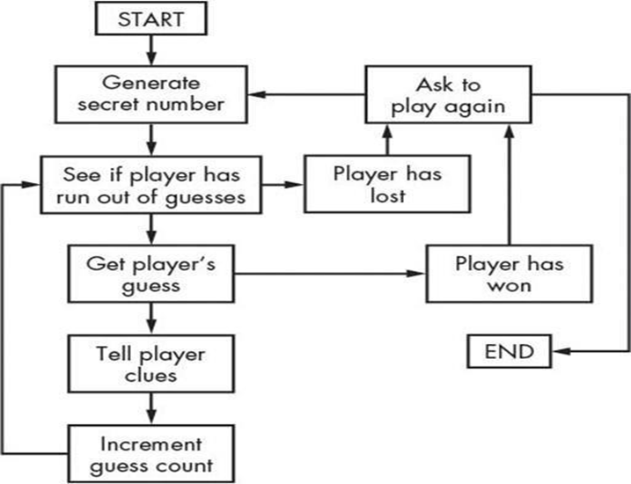
ARCHITECTURE DIAGRAM
IIIIIIIIIIIIIIIIIII
IIIII

Slide 8
MODULES
Game Initialization Module: Handles the setup of the game, including generating the random number, initializing variables like the number of attempts, and setting the difficulty level based on user selection.
Input Handling Module: Manages player interactions by accepting guesses and ensuring input is valid (e.g., within the specified range and numeric).
Feedback and Evaluation Module: Provides feedback for each guess and evaluates game progress.
Difficulty Management Module: Manages the game settings for different difficulty levels.
Replay and Exit Module: Provides options for players to replay the game or exit after a round.

Slide 9
MERITS
Event Organization: Simplifies planning and managing alumni events.
Networking: Helps alumni connect for job opportunities and mentorship.
Easy Communication: Makes it easier for alumni and the institution to stay in touch.
Data Storage: Keeps alumni information organized and accessible.

Slide 10
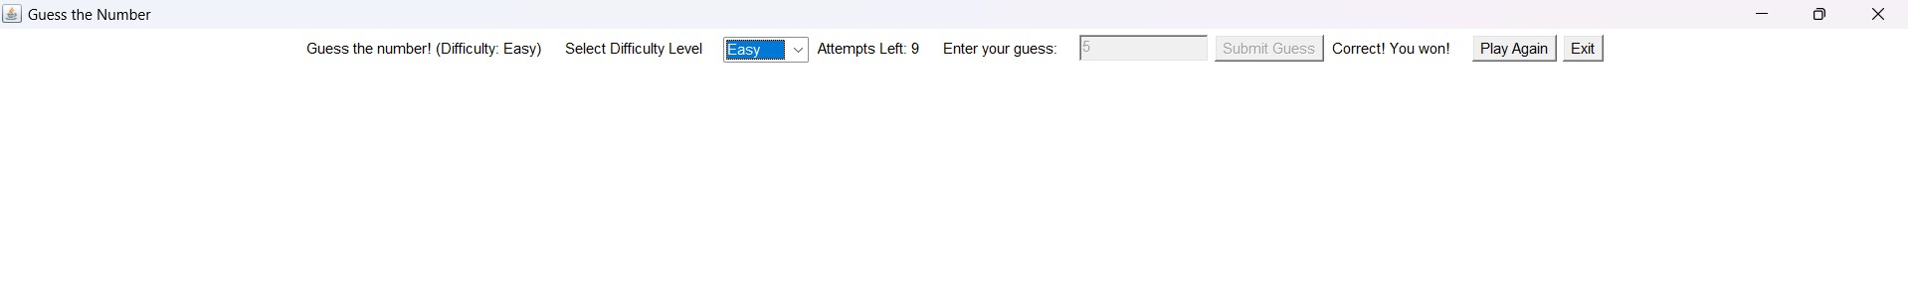
RESULTS AND DISCUSSION
DIFFICULTY LEVEL: EASY

Slide 11
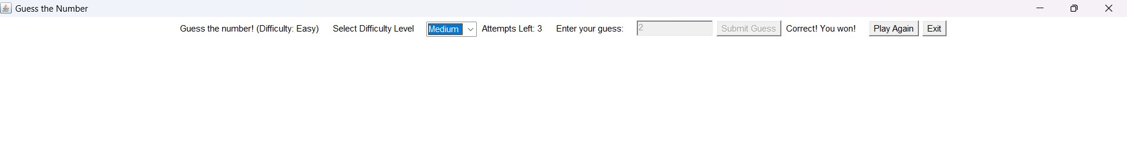
RESULTS AND DISCUSSION
DIFFICULTY LEVEL: MEDIUM

Slide 12
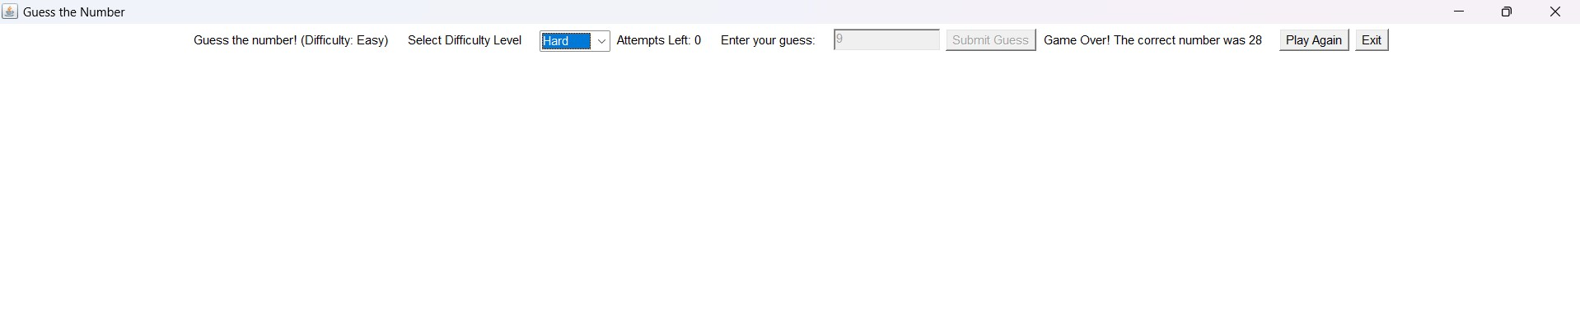
RESULTS AND DISCUSSION
DIFFICULTY LEVEL: HARD

Slide 13
ANY QUERIES ?

Slide 14
THANK YOU

